Slide 1
International Business Machines Corporation
Sector: Information Technology
Industry: IT Service (Software, Consulting, Infrastructure)
Recommendation: BUY
Presented By:
Weiqiang Wu, Abhishek Goyal, Vatsal Raj

Slide 2
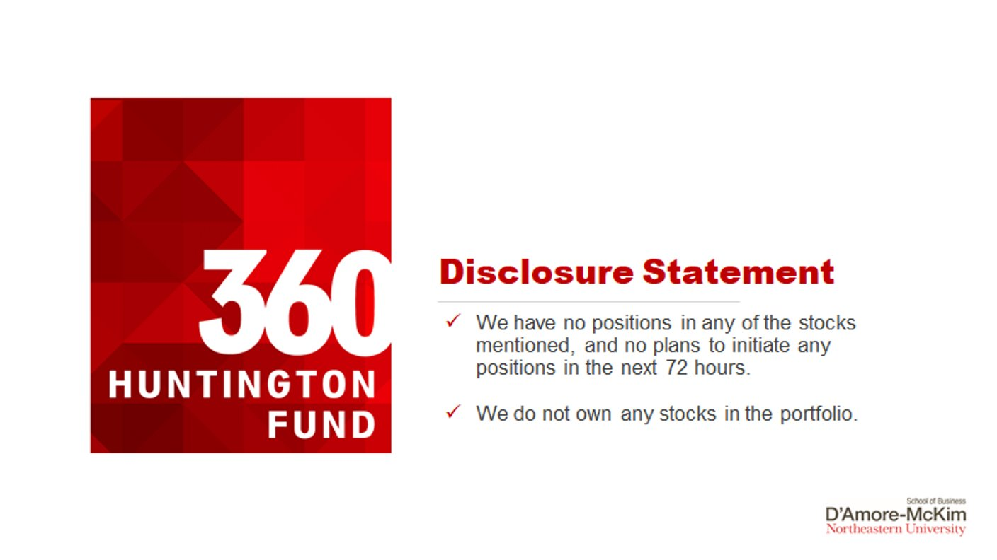

Slide 3
TABLE OF CONTENT
Company Overview
Segment Details
Industry Overview
SWOT Analysis
Competitors
Catalyst
Investment Thesis
Risk
Valuation
Portfolio Consideration

Slide 4

Business Overview
Armonk, New York, US
288,300 (FY 2022)
60.5 billion (FY 2022)
- Microsoft
- Accenture
- SAP
IBM (International Business Machines Corporation) is a multinational technology company headquartered in Armonk, N.Y. It was founded in 1911. IBM offering a portfolio of middleware for collaboration, predictive analysis, software development and systems management.
Business Segments:
- IBM Software(IBM Cloud Paks): Automation, Data and AI, Security, Transaction Processing
- IBM Consulting: Business Transformation, Technology Consulting, Application Operations
- IBM Infrastructure: IBM Z, Distributed Infrastructure, Infrastructure Support

Slide 5
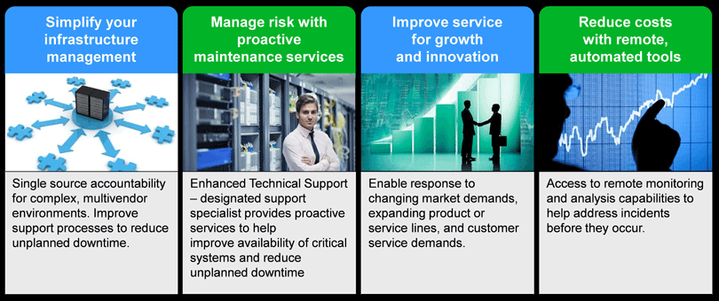
About International Business Machines Corporation (IBM)
A global leader in smart, healthy and sustainable buildings, serving in 150 countries.
Company Overview: Key Stats:
Share Price: $141.62 | Market Cap: 129.03Bn

Slide 6
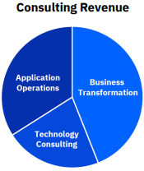
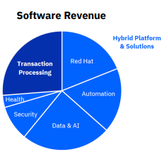
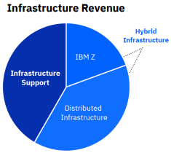





Segment Details
6% Consulting revenue growth
8% Software revenue growth
3.6 B in revenue

Slide 7
Company Overview: New ESG Commitments
Net zero GHG emissions by 2030
Divert 90% by weight of nonhazardous waste from landfill and incineration by 2025
100 client engagements or research projects with environmental benefits by 2025
Improve average data center cooling efficiency 20 percent by 2025 against base year 2019.
For server products with a valid upgrade path, reduce power consumption per unit of delivered work versus the previous generation.
Send no more than 3 percent (by weight) of end-of-life product waste to landfill or to incineration for treatment. Recycle or reuse at least 97 percent (by weight).

Slide 8
Company Overview: Business Strategy
Capitalize on Key Growth Factors
Global Expansion and Increased Outsourcing
Focus on core business activities

Slide 9
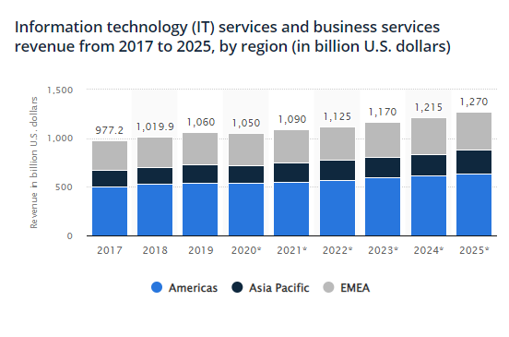
Industry Overview
IT Services
Information technology (IT) services are services used by organizations to create, manage, and deliver information, next to assisting with other business functions. Services include consulting, software development, systems integration, as well as hardware deployment and education. As a whole, the broader market for IT services is made up of several segments, including outsourcing, managed services, security services, data management, and cloud computing.
Generally, the profitability of companies in the industry depends on their ability to innovate their services and grow their technical expertise. Indeed, both smaller and larger companies can compete in this industry: larger companies offer broader services and have a global reach, while smaller companies tend to position themselves in niche markets and tailor their offerings more specifically to customers’ needs. The most substantially growing segment of IT services is cloud computing which drives IT-related innovation.

Slide 10




Competitors
 | IBM | SAP | Accenture | Microsoft
Business | Software, Consulting, Infrastructure | Cloud, Software | Consulting, Products | Business Processes, Cloud, Personal Computing
Market Cap | 129.39B | 153.137B | 196.526B | 2.431T
Q2 Free Cash Flow(M) | 2,151 | 711 | 3,229 | 19,827
Q2 Revenue(M) | 15,475 | 7,555 | 15,985 | 56,189
Dividend Yield | 4.69% | 1.71% | 1.44% | 0.92%

Slide 11
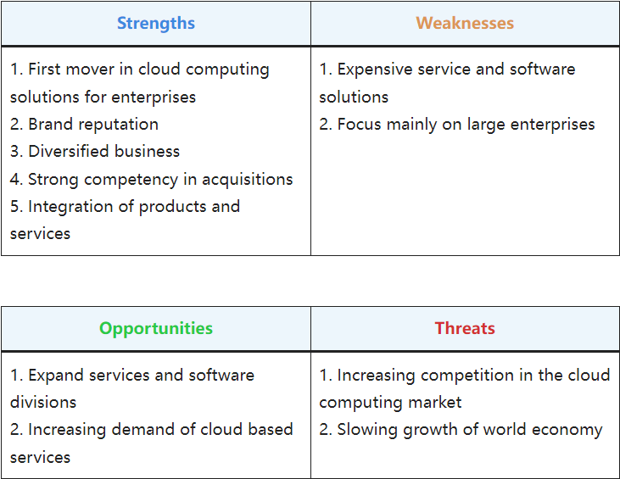
SWOT Analysis

Slide 12
Investment Thesis
2023 Expectations: Steady 3-5% revenue growth, $10.5B+ free cash flow.
YoY pre-tax income margin improves by 12 points (GAAP) and 0.5 points (non-GAAP).
Free cash flow of ~$10½ billion,
up >$1 billion yr/yr
12

Slide 13
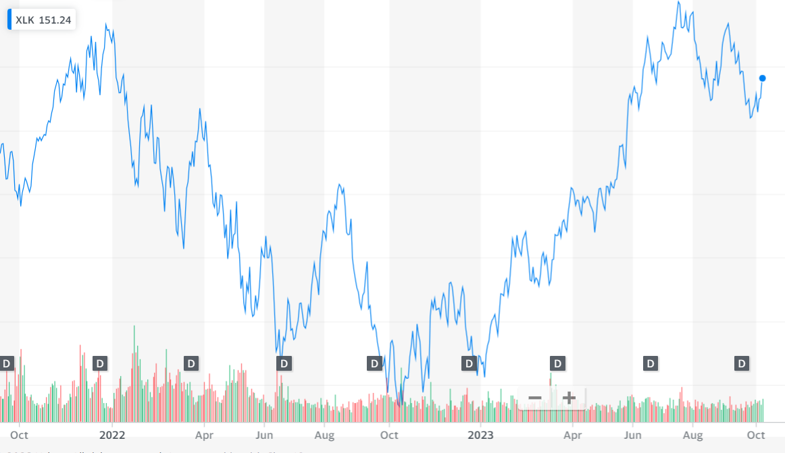
Catalyst : Market Trend and AI
Open AI hit the market with Chat GPT on 20th November 2022
The IT sector has since then grown to 37% to an all-time high
Only now does the trend start to slow down post august23

Slide 14
What are the key ingredients for AI application to thrive:-at an AI application needs to thrive
Infrastructure (graphic processing units)
Software
Data
AI application

Slide 15
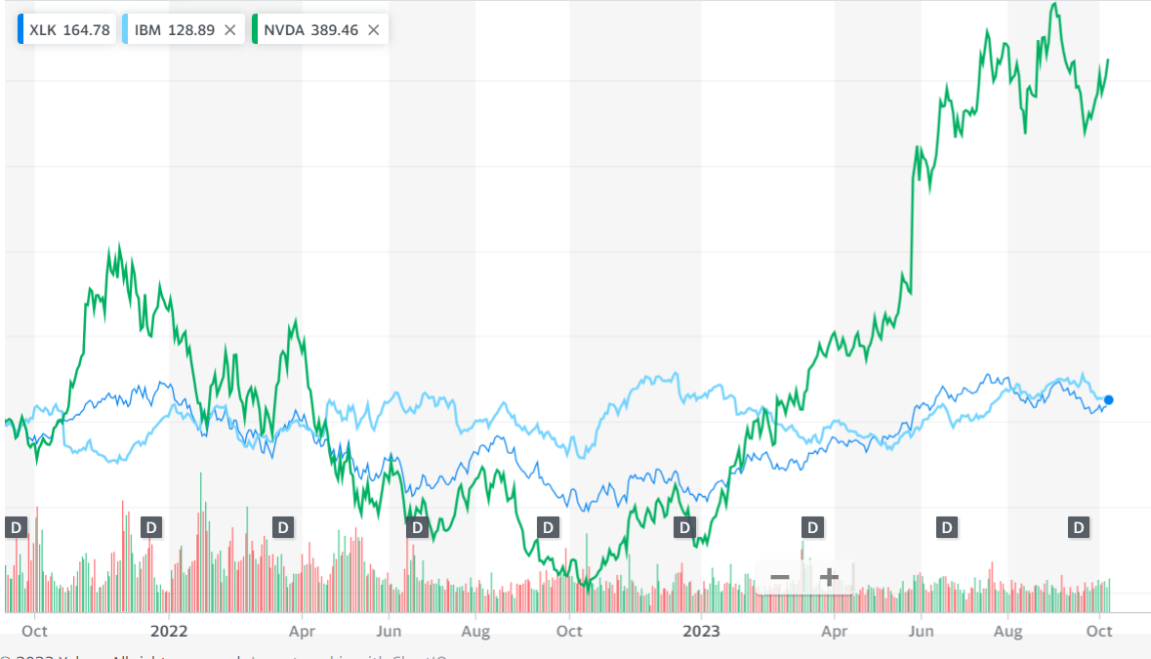
Catalyst: AI Boom
IBM started investing into AI in 2012 but faces a very different trend from other AI related companies like INVIDIA
IBM and invidia have stark comparisons with respect to AI interaction with the industry
Yet INVIDIA is the 4th highest value share in the S&P500 with the stock valued at 440$
While IBM is the 53rd on the S&P500 with a stock value floating 142

Slide 16


Investment Thesis: Industry Comparison
Main Business Focus | Graphics Processing Units, Artificial Intelligence, Gaming | Information Technology, Cloud Computing, AI, Software
AI Focus | Strong focus on AI with AI-specific products and technologies | Integrating AI into user products, software development for customers
Silicon Infrastructure | Provides Silicon infrastructure for AI industry | Primarily software-focused with limited hardware infrastructure
Late Beneficiary in AI | Early beneficiary, provides hardware infrastructure to support AI | Late beneficiary, will roll out integrated AI products to capitalise on AI market
2024 AI Objective | Capitalizing on investments made earlier before | Focusing on AI innovation and product development
Key takeaways :
NVIDIA's early beneficiary of the AI boom but it in-fact it is tangentially associated with AI as it provides AI infrastructure and not AI-SW itself
The infrastructure now promotes SW companies to capitalise on the market with AI integrated tools and services
Key Insights
IBM's early investment into AI has been waiting to release its AI integrated products to a market ready to absorb.
We area at a stage where 65% business owners believe that an AI-Hybrid customisable platforms suit their industry

Slide 17
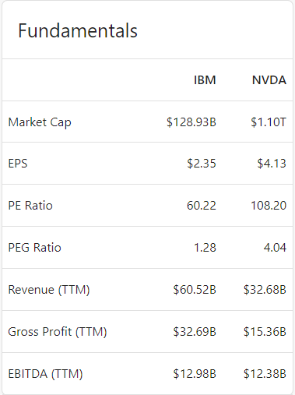
Furthermore....
Observing one of the key differences between IBM and NVIDIA we see, NVIDIA has a very hive P/E value.
The High P/E ratio is the reason for NVDA being overvalued
IBM is yet to receive the same benefits of the AI boom but it is possible IBM faces the same phenomenon in FY24

Slide 18

Introducing WatsonX
Watson X is predicted to be a ground breaking application being launched by IBM
It caters to the Industrial AI community making it easier for them to design, train, tune and implement their custom AI tools
With this new product IBM aims to compete with AWS, Microsoft and google in the cloud computing and AI space
If WatsonX is able to deliver the AI training capability it promises it will be a highly disruptive piece of SW that can catalyze IBM's position in the market

Slide 19
Why is WatsonX a disruptive tech
Comprehensive Functionality: The platform consolidates diverse operations into a unified solution.
Cross-Platform Compatibility: It offers cross-platform support for enhanced accessibility.
Powered by Presto and Spark: Empowered by industry-leading Presto and Spark technologies.
Iceberg Open Table Format: Supports the user-friendly Iceberg platform.
User-Friendly: Approachable for users with varying skill levels.
Integration Flexibility: Allows seamless integration of SaaS and custom plugins.
Customizable AI Models: Provides users the flexibility to tailor their hybrid AI models.
Cost-Effective AI: Enhances cost-effectiveness in AI integration.
Security and Compliance: Ensures self-service access, security, and compliance with regulations.
Model Database: Backed by a comprehensive database of pre-prepared models.
Automated Data Management: Offers automated local data management solutions.
Seamless Data Integration: Easily integrates with existing data sources for better decision-making.

Slide 20

Accusation of Apptio
Apptio is being acquired by IBM to address the growing complexity of IT environments in the era of digital transformation.
Apptio's solutions offer integrated visibility into technology spend across hybrid and multi-cloud setups, aligning with IBM's IT automation software and watsonx AI platform.
Apptio serves over 1,500 clients, including more than half of the Fortune 100, and partners with major cloud providers and technology companies.
The acquisition brings $450 billion of anonymized IT spend data to IBM, enhancing insights for clients and partners.
The deal is part of IBM's strategic focus on hybrid cloud and AI and is expected to create synergies across various growth areas, including automation, Red Hat, AI, and consulting, benefiting clients worldwide.

Slide 21

Risk
Increasing competition in cloud computing market. Cloud computing market is new and lucrative market that has a lot of growth potential. The possible profits attract many newcomers and startups and threaten to take the market share from IBM.
Slowing growth of world economy. As mentioned earlier, IBM sales heavily depend on the enterprises’ willingness to make huge investments into IT infrastructure, which is far from the first option during the times of slow economy growth. While this scenario is not forecasted for the whole world during 2013 and 2014, some regions, like Europe, will still struggle to grow.

Slide 22
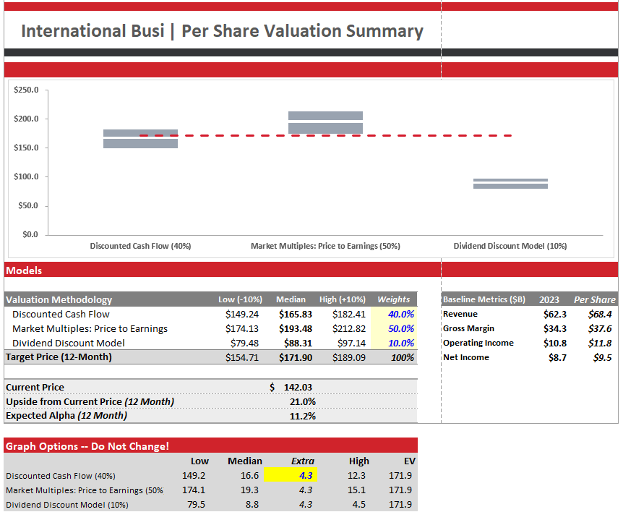
Valuation

Slide 23
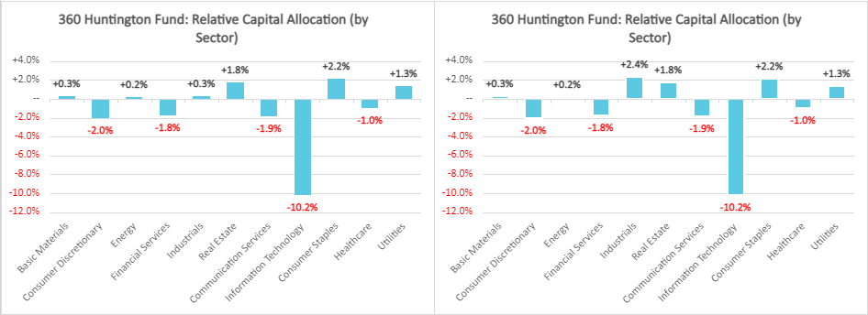
Portfolio Considerations
Information Technology -10.2% compare with benchmark index.
IBM is 0.31% weighted in Russell 3000
Improve the correlation with benchmark index.
With a A- credit rating, would be beneficial in the high-rate environment.

Slide 24
Thank You

Slide 25




For Reference
FINANCING | INFRASTRUCTURE | SOFTWARE | CONSULTING
This segment provides financing solutions to help clients acquire IBM products and services. IBM's financing solutions include leasing, loans, and lines of credit. | This segment provides hardware and software products and services for hybrid cloud and AI infrastructures. IBM's infrastructure products include Power Systems, Storage Systems, and Z Systems. | This segment develops and sells software products for a variety of industries, including healthcare, financial services, retail, and manufacturing. IBM's software products include Watson AI, Cloud Pak for Data, and Security and Compliance Suite. | This segment provides consulting services to help clients improve their business performance and solve their most complex problems. IBM's consulting services include enterprise strategy, business transformation, process improvement, and technology implementation.

Slide 26


For Reference
Pros | Cons
When Arvind Krishna took over the CEO role in 2020, he transitioned its focus to cloud computing and artificial intelligence (AI). With the transition completed, this new IBM saw its share price jump on Sept. 20 after it garnered an outperform rating from investment bank RBC Capital analyst Matthew Swanson. IBM is among the six largest cloud computing companies in terms of market share. It benefits from the rapidly expanding hybrid cloud market, which was valued at $85 billion in 2021, and is forecast to increase to $262 billion by 2027. | Balance sheet is highly indebted . IBM’s asset turnover has worsened over the past five years. But, a good sign is that starting from late 2021 the declining trend seems to have reversed, and efficiency has gradually increased in the past quarters. The profit margins have decreased over the past few years .

Slide 27
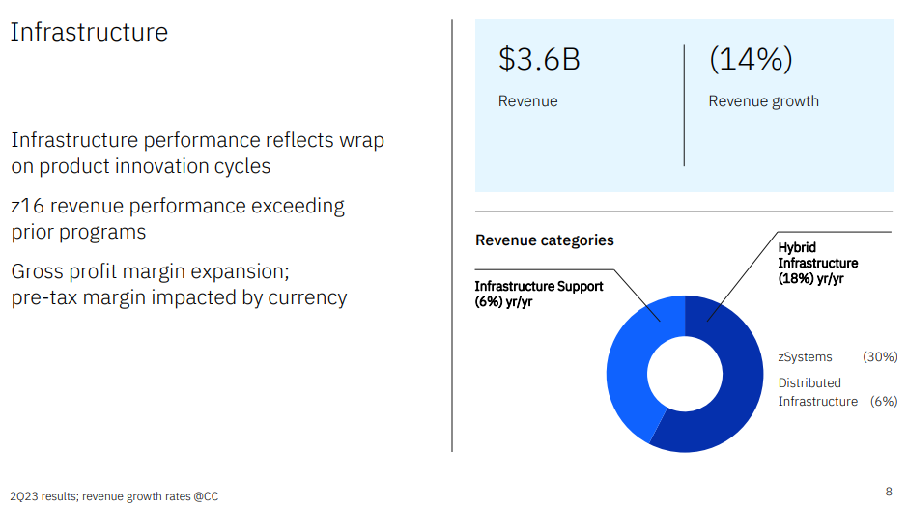
For Reference

Slide 28
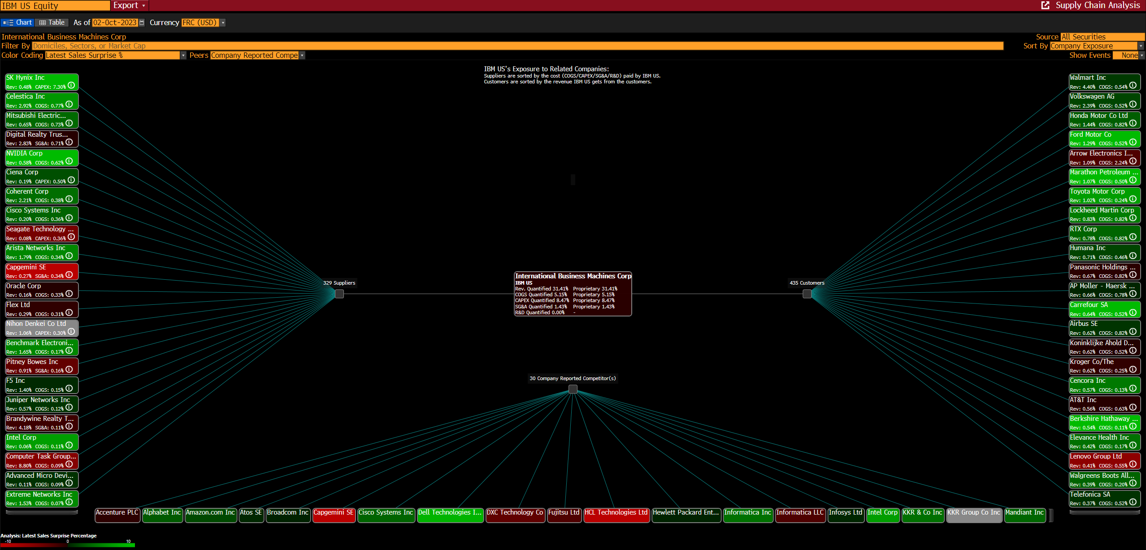
For Reference

Slide 29
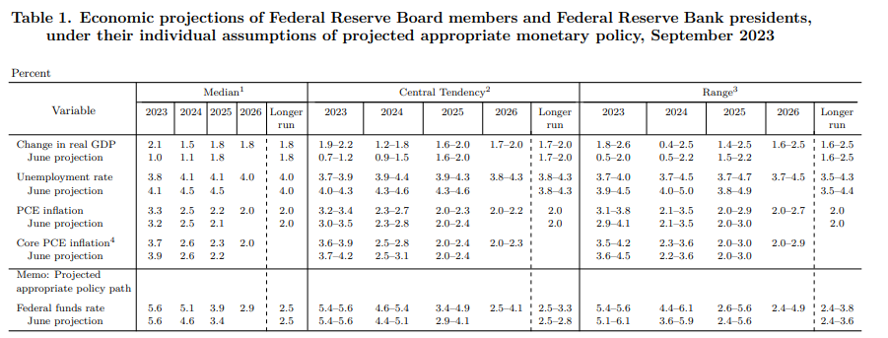
For Reference

Slide 30

For Reference

Slide 31
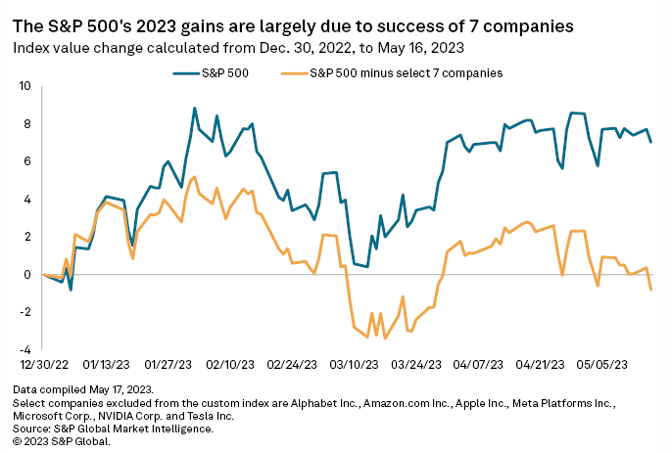
For Reference

Slide 32
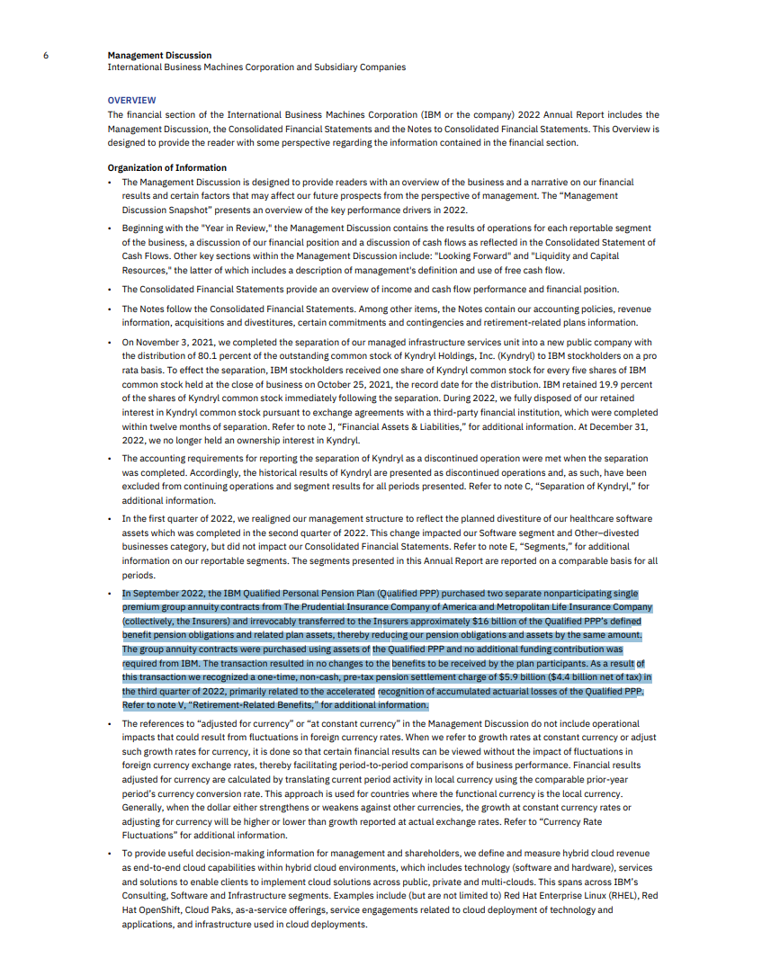
For Reference

